Slide 1
Section 1.6 Order of Operations with Integers Part1
© Copyright all rights reserved to Homework depot: www.BCMath.ca

Slide 2
Basic Operations
Adding, Subtracting, Multiplying, Dividing are the basic operations in mathematics
When an expression has more than one of these operation together, we need to process them in proper order
When adding or subtracting, either operation can be done first (Rule: Always go from “Left” to “Right”)
Likewise, when multiplying or dividing, either operation can be done first, always go from “Left” to “Right”
© Copyright all rights reserved to Homework depot: www.BCMath.ca

Slide 3
When adding, subtracting, multiplying, and dividing are all in one expressions, we must multiply or divide first. Adding or subtracting will be done afterwards
© Copyright all rights reserved to Homework depot: www.BCMath.ca

Slide 4
(Parenthesis)
Parenthesis are “brackets” in an equation
All expressions inside a bracket should be simplified before any operation outside of the brackets
© Copyright all rights reserved to Homework depot: www.BCMath.ca

Slide 5
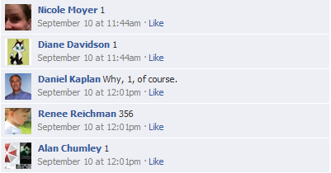

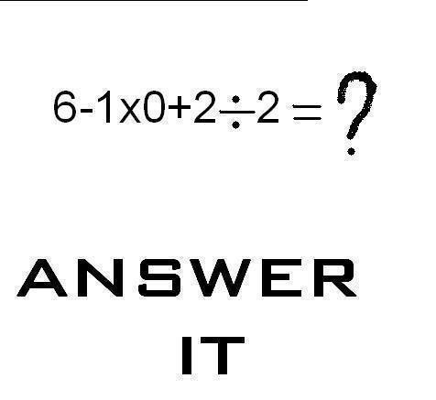
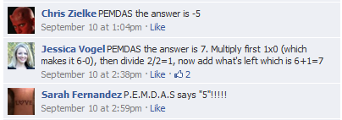
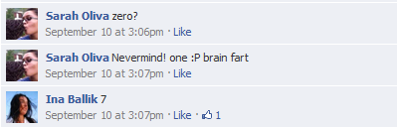
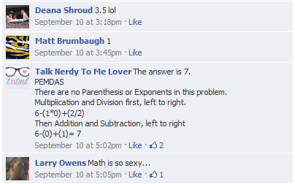
© Copyright all rights reserved to Homework depot: www.BCMath.ca

Slide 6
What is the first answer that you have in mind?
8 is wrong!!
© Copyright all rights reserved to Homework depot: www.BCMath.ca

Slide 7
Insert the proper operations (+ – ÷ ×) to make the statement true:
© Copyright all rights reserved to Homework depot: www.BCMath.ca

Slide 8
Homework
© Copyright all rights reserved to Homework depot: www.BCMath.ca

